Slide 1
Model: Class Diagram

Slide 2
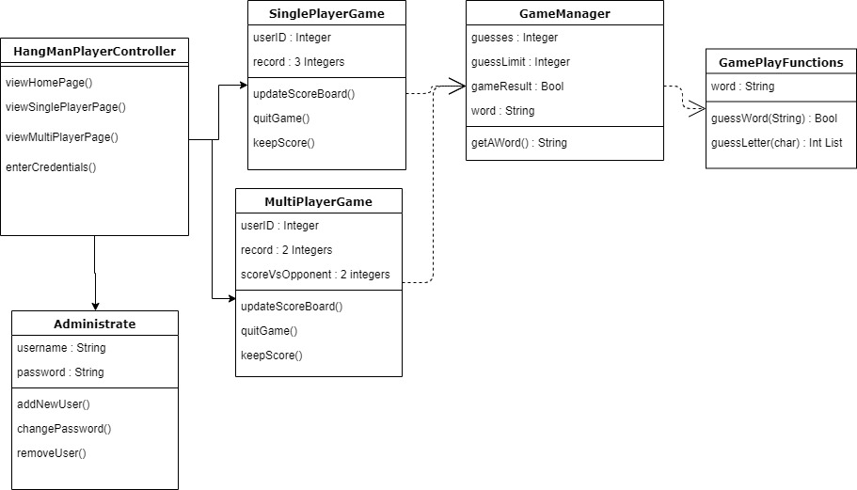
Class Diagram

